Slide 1
DevOps CA-II
Case Study Analysis & Implementation Report
Amazon case studies · CI/CD pipeline · Ansible IaC · Docker + Kubernetes · Prometheus & Grafana
Team Members
Rut Vaghani: 2370122186
Nihil Pandit: 24070122511
Harsh Trivedi: 24070122516

Slide 2
Contents
Part A — Case Study Analysis
A1
Q2 · Amazon — two-pizza teams & a deploy every 11.7 s
Part B — Implementation Tasks (one hello-service, end-to-end)
1
Task 1 · Deployment Strategy — GitHub Actions pipeline
2
Task 2 · Configuration Management & IaC — Ansible
3
Task 3 · Containerization & Orchestration — Docker + k3s
4
Task 4 · Monitoring & Logging — Prometheus + Grafana
5
Task 5 · Reflection & Report

Slide 3
PART A
Case Study Analysis

Slide 4
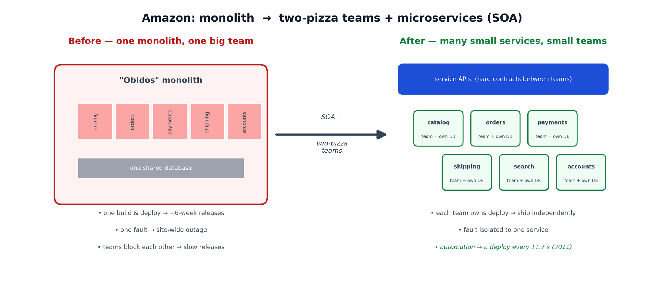
Q2 · Amazon — The Early-2000s Challenge
Rapid growth on a monolith caused frequent outages and slow releases, hurting revenue
“Obidos” monolith on shared databases
Frequent site-wide outages — one fault took down the whole site
Slow, infrequent big-bang releases
Coordination bottleneck — hundreds of engineers on one codebase
Vertical scaling limits; every outage hit customer experience and revenue
One monolith owned by one big team → many small services, each owned by a two-pizza team.

Slide 5
Q2 · Amazon — Solution & the Culture of Continuous Innovation
How DevOps solved it
~ every 11.7 s
Two-pizza teams — small autonomous teams own a service end-to-end
Microservices + the API mandate — services talk only through APIs (the seed of AWS)
CI/CD automation — thousands of independent, safe, continuous deploys
Organisation mirrors architecture — team boundaries match service boundaries
a production deployment across Amazon (2011) — the sum of thousands of tiny automated releases
Impact
Fault isolation → smaller, contained outages
Release cadence: weeks → seconds
Each service scales independently
Internal platform externalised → AWS was born

Slide 6
PART B
Implementation Tasks
One hello-service: provisioned → built → shipped → observed

Slide 7
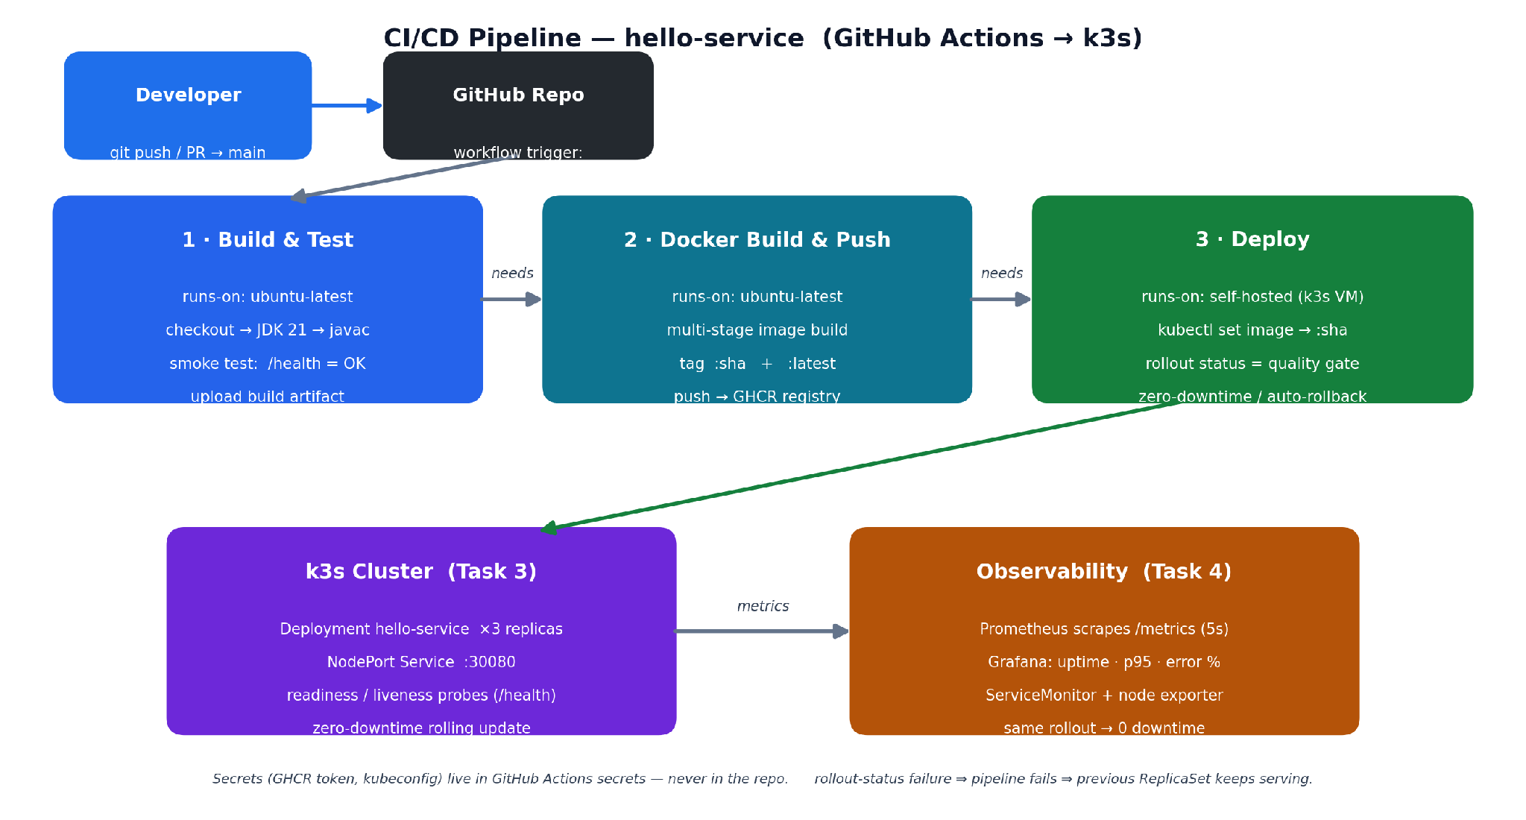
Task 1 · Deployment Strategy — GitHub Actions
Tool chosen: GitHub Actions — CI/CD lives in the repo and deploys straight to k3s
Trigger on push to main / manual — three dependent jobs run in order
Build & test (javac + /health smoke test) → Docker build & push to GHCR (tagged :sha) → Deploy to k3s
kubectl rollout status is the quality gate; a failed rollout triggers automatic rollback; secrets stay in Actions secrets

Slide 8
Task 1 · Workflow File & Pipeline Run
.github/workflows/deploy.yml
name: hello-service CI/CD
on: [ push(main), workflow_dispatch ]
jobs:
build-and-test: # ubuntu-latest
setup-java 21 -> javac Main.java
smoke test: /health == 200
upload build artifact
docker-build-and-push: # needs build-and-test
login GHCR (GITHUB_TOKEN)
docker build (multi-stage)
tag :<sha> + :latest -> push
deploy: # needs docker-build
runs-on: self-hosted (k3s VM)
kubectl set image ...hello-service=:<sha>
kubectl rollout status # quality gate
if failure -> kubectl rollout undo

Slide 9
Task 2 · Configuration Management & IaC — Ansible
Agentless over SSH — declares the desired state of a Debian host and enforces it idempotently
Installs packages (htop, tree, jq)
Creates a managed service account (devops-lab)
Manages config files (/etc/motd banner + README)
Idempotent — 1st run changed=4, 2nd run changed=0
Secrets kept out of the repo (ansible-vault, not plain text)
playbook.yml (tasks)
- hosts: ca2_vm
become: true
tasks:
- apt: {name:[htop,tree,jq], state:present}
- user: {name:devops-lab, shell:/bin/bash,
create_home:true}
- copy: {dest:/etc/motd, content:'...banner'}
- copy: {dest:/home/devops-lab/README.txt,
content:'...managed by Ansible'}
# inventory.ini
[ca2_vm]
192.168.1.109 ansible_user=zeyo

Slide 10
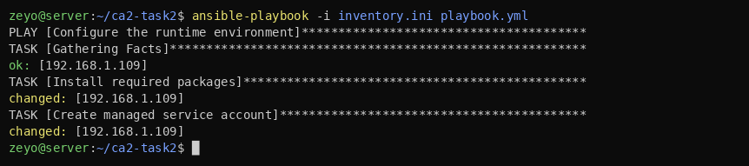
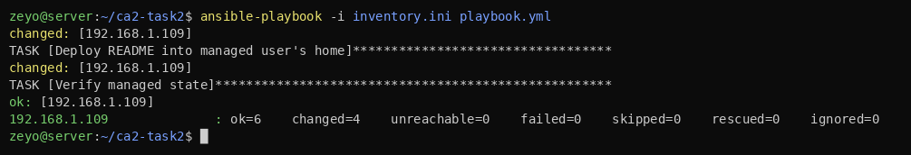
Task 2 · Playbook Run (first run)
First run — gathers facts, installs htop/tree/jq and creates the devops-lab service account (changed).
First run completes — MOTD & README deployed; PLAY RECAP: ok=6 changed=4 unreachable=0 failed=0.

Slide 11
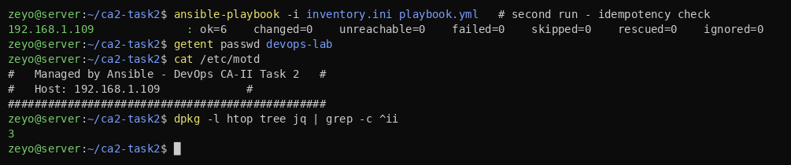
Task 2 · Idempotency & Verification
Second run changes nothing (changed=0) — the host already matches the declared state; getent, /etc/motd and dpkg confirm it.
changed=0 Re-running the same playbook is safe — the core property of Infrastructure as Code: declare the state once, enforce it anywhere, repeatedly.

Slide 12
Task 3 · Containerization & Orchestration — Docker + k3s
Multi-stage image on a 3-replica Deployment; rolling update 1.0 → 2.0 and rollback, zero downtime
Multi-stage Dockerfile — JDK builds, JRE runs; non-root; APP_VERSION baked in
Deployment: 3 replicas + NodePort Service (:30080)
readiness / liveness probes on /health
RollingUpdate: maxUnavailable 0, maxSurge 1 → never drops below 3 serving pods
Each version = its own ReplicaSet → rollback is instant
strategy (deployment.yaml)
strategy:
type: RollingUpdate
rollingUpdate:
maxSurge: 1 # +1 extra pod
maxUnavailable: 0 # zero downtime
readinessProbe: { httpGet: /health }
livenessProbe: { httpGet: /health }
replicas: 3
service: NodePort 30080 -> 8080

Slide 13
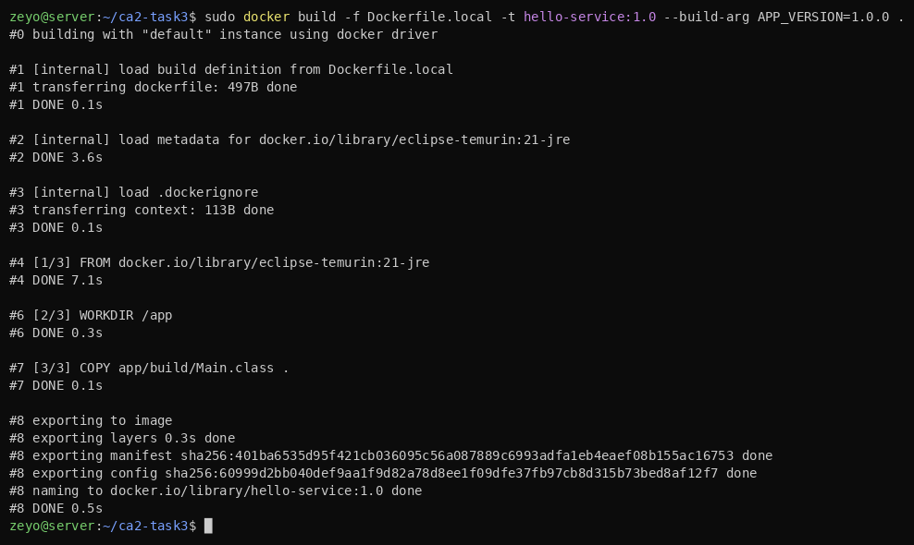
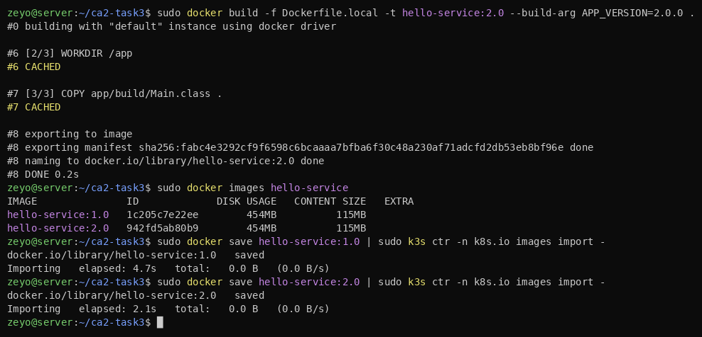
Task 3 · Build the Images
Build image v1.0 — multi-stage Docker build (runtime-only variant used on the VM).
Build v2.0 (only APP_VERSION differs) and load both tags into the cluster's containerd.

Slide 14
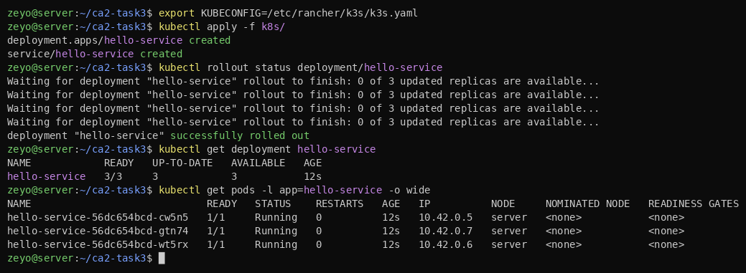
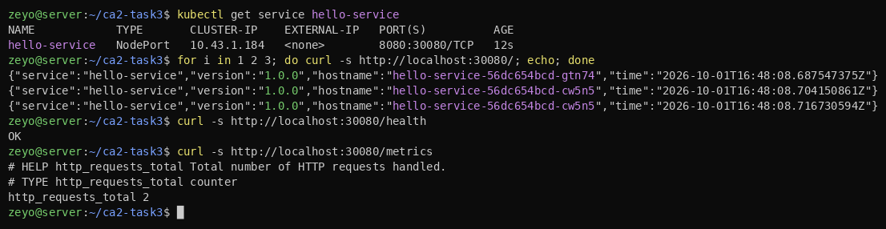
Task 3 · Deploy & Access
kubectl apply -f k8s/ — Deployment + Service created; rollout succeeds; all 3 pods 1/1 Running.
curl via NodePort :30080 — requests load-balanced across pods; /health OK; /metrics exposed.

Slide 15
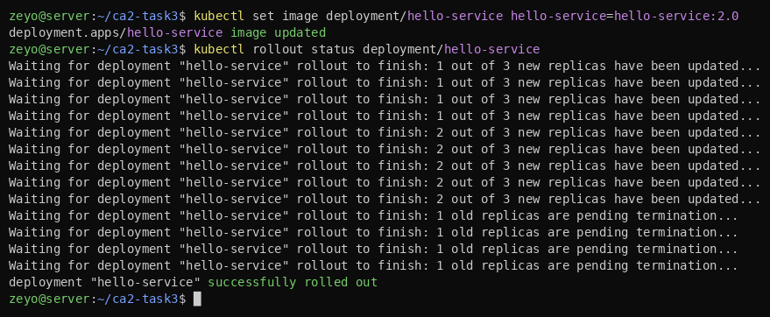
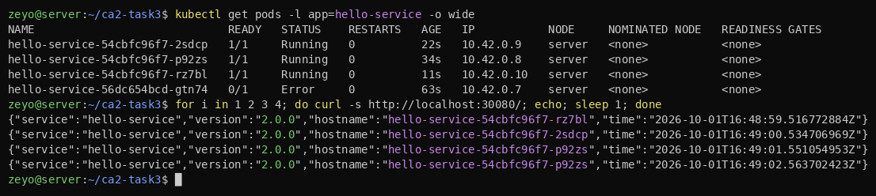
Task 3 · Rolling Update (1.0 → 2.0)
kubectl set image → staged rollout (new pods up, old terminating) finishes with zero downtime.
All serving pods now on the new ReplicaSet; the service responds with version 2.0.0.

Slide 16
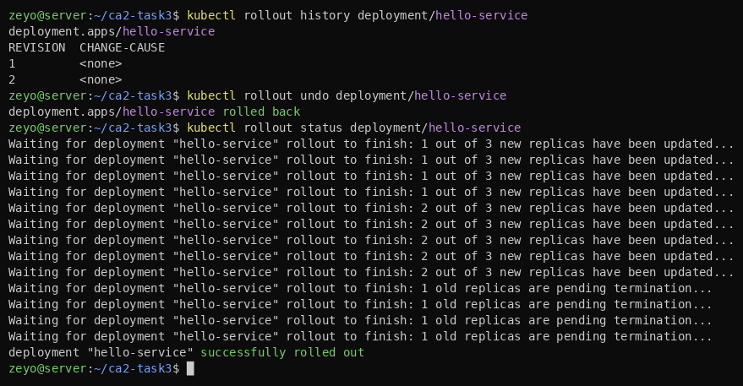
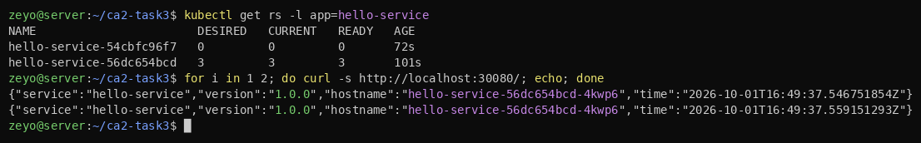
Task 3 · Rollback (2.0 → 1.0)
kubectl rollout history + undo — returns the Deployment to the previous revision.
Rollback verified — v2 ReplicaSet scaled to 0, v1 back at 3/3; the service answers 1.0.0 again.

Slide 17
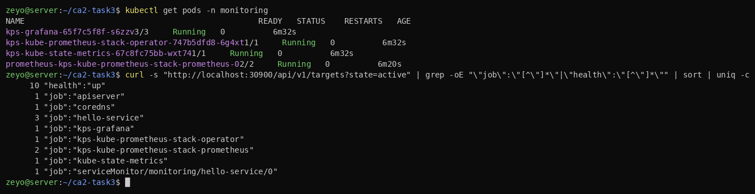
Task 4 · Monitoring & Logging — Prometheus + Grafana
kube-prometheus-stack scrapes every pod; the service emits histogram + per-status-code metrics
Prometheus + Grafana via the kube-prometheus-stack Helm chart (NodePorts 30900 / 30300)
A ServiceMonitor scrapes all 3 hello-service pods every 5 s; the host node exporter is an extra target
Dashboard panels: uptime, total requests, error rate %, request rate, and latency p50 / p95
kube-prometheus-stack pods Running; 10 Prometheus targets healthy, including the 3 hello-service pods and the node exporter.

Slide 18
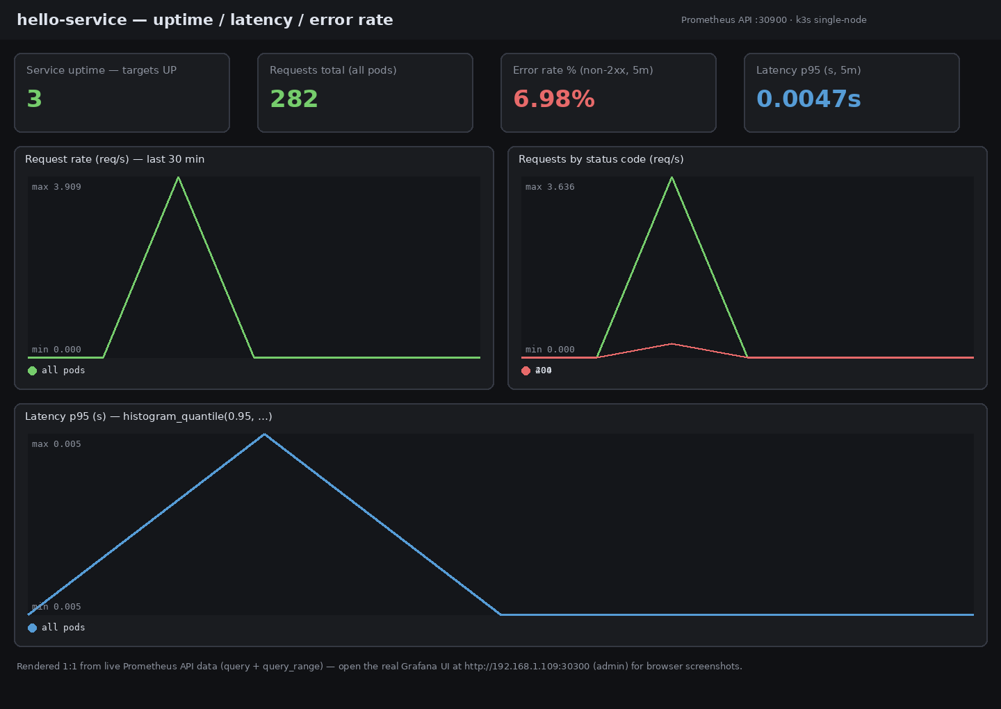
Task 4 · Grafana Dashboard (live data)
Uptime 3/3 targets up · 282 requests · error rate ~7% (from deliberate 404s in the load test) · latency p95 ≈ 4.7 ms — rendered 1:1 from the Prometheus API.

Slide 19
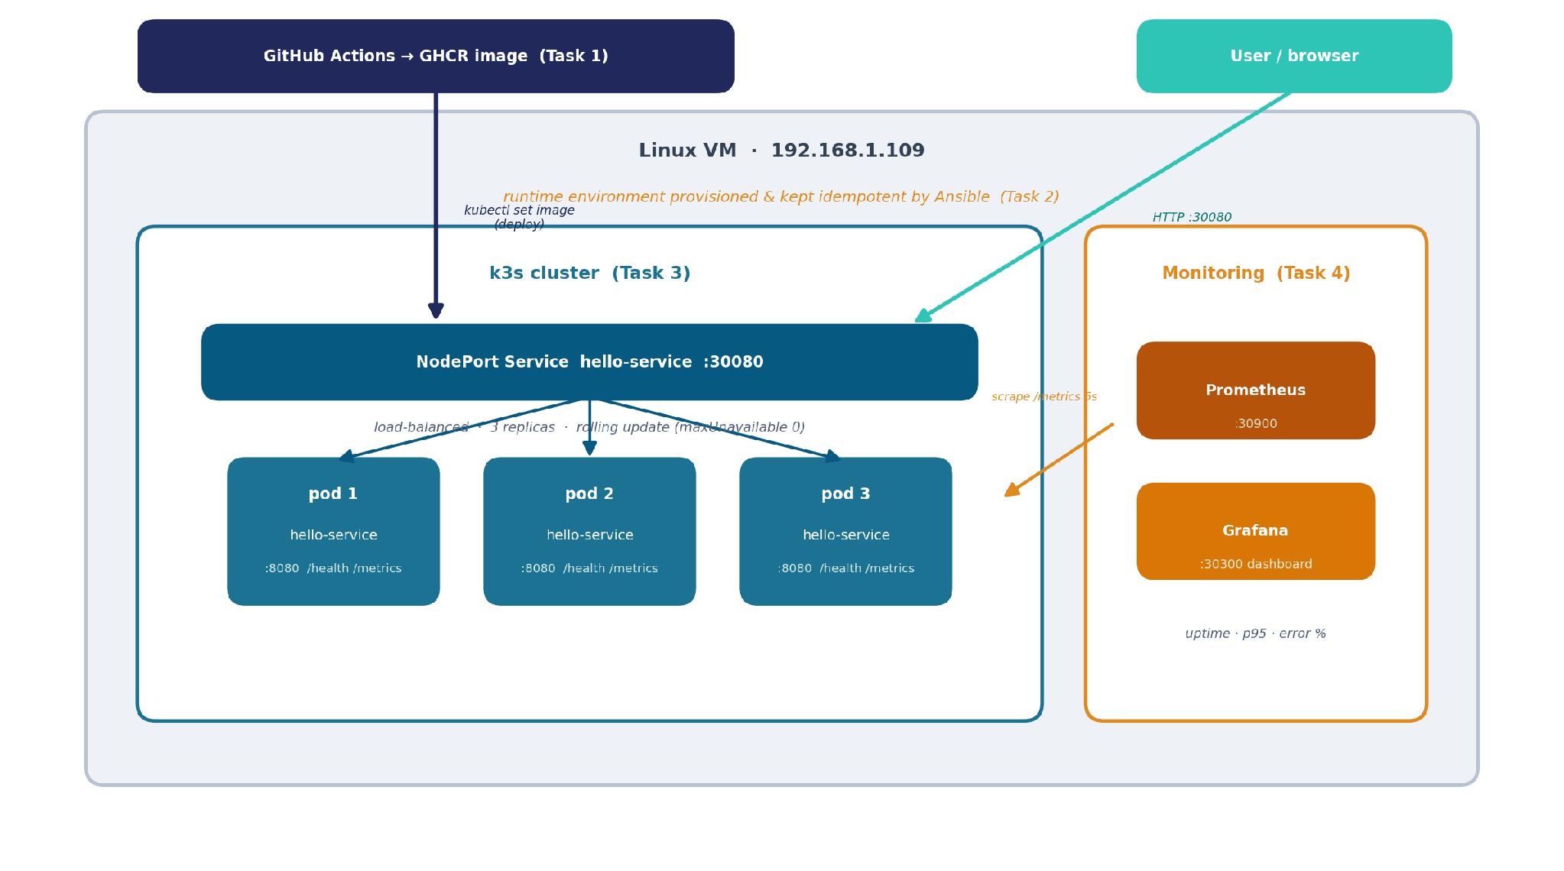
Task 5 · System Architecture
Each DevOps task is one layer of the same running system
GitHub Actions deploys the image into a k3s cluster on an Ansible-provisioned VM; Prometheus + Grafana observe the pods; users reach the service via NodePort.

Slide 20
Task 5 · Challenges We Hit
1
Tiny disk on the VM
/var was too small for a normal image build — built a runtime-only image and loaded it with docker save | k3s ctr images import.
2
Genuine zero-downtime updates
Needed maxUnavailable: 0 + a readiness probe so a new pod only takes traffic after /health passes.
3
Ansible idempotency & secrets
Getting a clean changed=0 on re-runs, and keeping the become password out of the repo (ansible-vault).
4
Dashboards need real metrics
Prometheus shows only what the app emits — upgraded the service to expose a latency histogram + status counters.
5
Deploying on-prem from GitHub
Hosted runners can't reach 192.168.x — deployment runs on a self-hosted runner on the k3s VM.

Slide 21
Task 5 · Lessons Learned
Declarative, idempotent IaC
Zero-downtime is a design choice
Ansible + K8s manifests make the whole environment reproducible and safe to re-apply.
Readiness probes + RollingUpdate give it; separate ReplicaSets make rollback instant.
You can't monitor what you don't emit
Immutable, SHA-tagged images
Observability must be built into the service, not bolted on afterwards.
Every deployment maps to an exact commit, so rollbacks are deterministic.
Automate the whole path
Keep secrets out of code
commit → build → deploy behind quality gates turns releases into routine events.
GitHub Actions secrets, GITHUB_TOKEN and ansible-vault — never credentials in the repo.
hello-service: from a code push to a monitored, zero-downtime production release — fully automated.

